Slide 1
Employee Data Analysis using Excel
STUDENT NAME: DHANUSH.M
REGISTER NO:122200915,ABA21D8D82F1D93B8C447104884B5A74
DEPARTMENT: BACHELOR OF COMMERCE (CORPORATE SECRETARYSHIP)
COLLEGE: K.C.S.KASI NADAR COLLEGE OF ARTS AND SCIENCE

Slide 2
PROJECT TITLE
Project Based on Department using Excel

Slide 3


AGENDA
Problem Statement
Project Overview
End Users
Our Solution and Proposition
Dataset Description
Modelling Approach
Results and Discussion
Conclusion
3/21/2024 Annual Review

Slide 4

PROBLEM STATEMENT
This project Define the purpose of the analysis, such as improving project timelines, identifying bottlenecks, or assessing employee performance.
Data Collection: Gather data on project deadlines, completion dates, and employee involvement. This may include project management tools, timesheets, and performance reviews.
Metrics: Completion Rates: Percentage of projects completed on time vs. late.
Duration: Time taken to complete projects versus the estimated time.
Quality: Assess the quality of completed projects, including client satisfaction and error rates.
Employee Performance: Individual contributions, adherence to deadlines, and efficiency.

Slide 5

PROJECT OVERVIEW
Objective: The goal of this project is to analyze and evaluate employee performance in relation to project completion. This analysis aims to identify trends, assess productivity, and determine areas for improvement to enhance overall project management and employee efficiency.
Scope: The analysis will cover project completion data for all employees within the Marketing and Development departments over the past 12 months. The focus will be on understanding completion rates, adherence to deadlines, and quality of deliverables.
.

Slide 6

WHO ARE THE END USERS?
Management and Executives: They use the data to assess overall performance, make strategic decisions, and allocate resources effectively.
Project Managers: They need insights to track project progress, identify issues, and ensure projects stay on schedule and within budget.
Human Resources: They analyze the data to evaluate employee performance, identify training needs, and make decisions about promotions or hires.
Team Leaders and Supervisors: They use the data to understand their team's productivity, address any concerns, and provide feedback.
Finance Departments: They review the data to assess cost efficiency and financial impact of projects.
Clients or Stakeholders: They may be provided with relevant data to ensure transparency and demonstrate project outcomes or success.

Slide 7

OUR SOLUTION AND ITS VALUE PROPOSITION
ALIGNMENT: To enhance the visual presentation of data.
FILTERING: Select any cell within the range.
REMOVE DUPLICATES: Permanently deleting duplicate valuesDouble tap to add title
CONDITIONAL FORMATTING: Makes it easy to highlight certain values.
BOLD TEXT: This will turn all the text in all selected cells bold
GRAPH: Represent data in a worksheet
PIVOT TABLE: To summarize, analyze, explore and present summary data.
software filters used along with excel tables or pivot tables over a large amount of data

Slide 8
Dataset Description
AVERAGE_MONTLY_HOURS: This column seems to contain the average number of hours worked per month by an employee.
TIME_SPEND_COMPANY: This column likely represents the number of years the employee has worked at the company.
WORK_ACCIDENT: This column is likely a binary indicator (0 or 1) of whether the employee has had a work accident.
LEFT: This column is probably another binary indicator (0 or 1) showing whether the employee has left the company.
PROMOTION_LAST_5YEARS: This column indicates whether the employee has received a promotion in the last five years.
POSITION: This column shows the job title of the employee.SALARY: This column shows the salary level of the employee (low, medium, or high).

Slide 9
MODELLING
Data set was downloaded from kaggle website Extract it from zip formatData Cleaning: Data cleaning is a process required to remove incomplete records, and modifying data to rectify inaccurate records.Remove Duplicates It removes the combination of values across all selected range to determine duplicates.Filter: It take my dataset and show only the data that meet my criteria specifyConditional Formating: It is used to specify important values stand out in employee performance score in a data set Slicer: I used slicer to fliter my dataPivot Table: I usad "pivot table to summarize my huge data Pivot Chart: I used using bar graph. "pivot chart" to visually summarises my data.
9

Slide 10
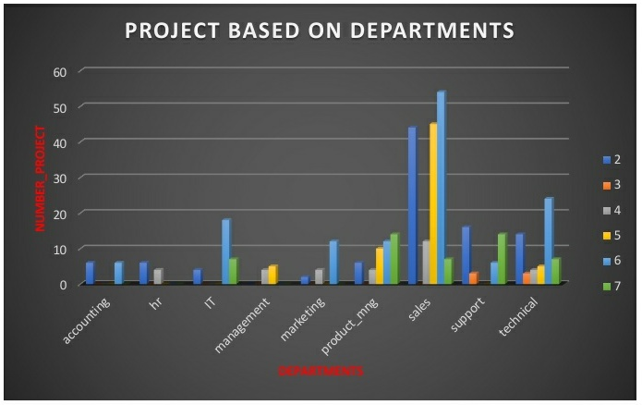
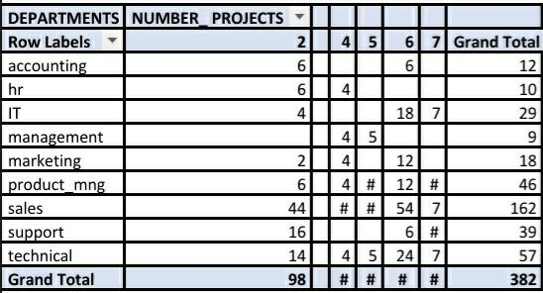
RESULTS
10

Slide 11
Conclusion The recent data project was completed successfully, demonstrating the employee’s proficiency in handling complex data sets and delivering actionable insights. The project objectives were met on time, and the quality of analysis was high, providing valuable contributions to the organization’s strategic goals.

